Slide 1
EC3357:Machine Learning
Lecture 3b: Multi-Linear Regression

Slide 2
Simple Linear Regression
Simple regression problem (a single x and a single y), the form of the model would be:
b0 (y-intercept) and b1 (slope) are the coefficients whose values represent the accuracy of predicted values with the actual values.
Constant
Coefficient
y = b0 + b1 * x1
Dependent variable (DV)
Independent variable (IV)

Slide 3
Motivation
Single regression (i.e., with one IV) allows us to study the relationship between two variables only.
However, in reality, we do not believe that only a single variable explains all the variation of the dependent variable.
For example, in the scenario of IQ and income, we do not expect IQ only to explain income, but we expect that there are also other variables, such as years of education, to explain income.
Hence, to make the model more realistic, it makes sense to include multiple independent variables in the regression.

Slide 4
Examples
The following are situations where we can use multiple regression:
Testing if IQ and level of education affect income (IQ and years of education are the IV and income is the DV).
Testing if study time and pre-test scores affect final grades (DV is final grades, and study time and pre-test scores are the IV).
Testing if exercise and amount of salt in the diet affect blood pressure (exercise and salt are the IV and blood pressure is the DV).

Slide 5
More than one prediction attribute
X1, X2
For example,
X1=‘years of experience’
X2=‘age’
Y=‘salary’
Equation:

Slide 6
Multi Linear Regression
Constant
Coefficients
y = b0 + b1 * x1 + b2 * x2 + ... + bn * xn
Independent variables (IVs)
Dependent variable (DV)

Slide 7
Multiple linear regression requires at least two independent variables, which can be nominal, ordinal, or interval/ratio level variables.
A rule of thumb for the sample size is that regression analysis requires at least 20 cases per independent variable in the analysis.
Multiple linear regression requires the relationship between the independent and dependent variables to be linear.
The linearity assumption can best be tested with scatterplots. The following two examples depict a curvilinear relationship (left) and a linear relationship (right).
Multiple linear regression assumes that there is no multicollinearity in the data.
Multicollinearity occurs when the independent variables are too highly correlated with each other.

Slide 8
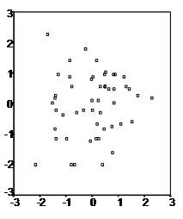
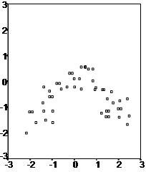
curvilinear relationship (left) and a linear relationship (right).

Slide 9
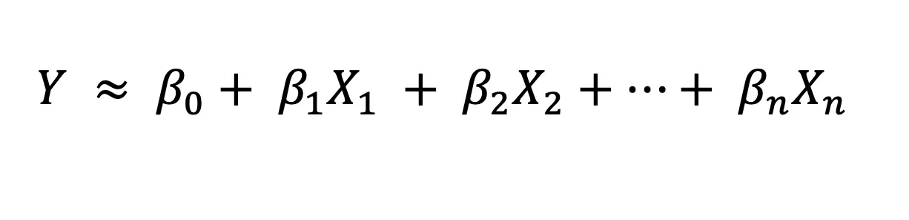
Linear Regression
Linear Regression is a statistical/machine learning technique that attempts to model the linear relationship between the independent predictor variables X and a dependent quantitative response variable Y. It is important that the predictor and response variables be numerical values. A general linear regression model can be represented mathematically as

Slide 10
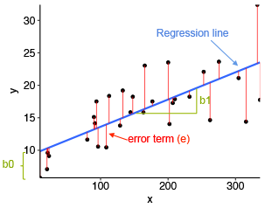
Example

Slide 11
Example (Cont..)
In the previous diagram,
x is our independent variable which is plotted on the x-axis and y is the dependent variable which is plotted on the y-axis.
Black dots are the data points i.e the actual values.
b_{o} is the intercept which is 10 and b₁ is the slope of the x variable.
The blue line is the best fit line predicted by the model i.e the predicted values lie on the blue line.
The vertical distance between the data point and the regression line is known as error or residual. Each data point has one residual and the sum of all the differences is known as the Sum of Residuals/Errors.

Slide 12
Assumptions of Linear Regression
Linear regression assumes that…
1. The relationship between X and Y is linear
2. Y is distributed normally at each value of X
3. The variance of Y at every value of X is the same (homogeneity of variances)
4. The observations are independent

Slide 13
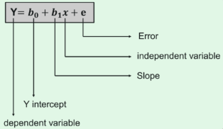
Linear Regression Terminologies: Cost Function
The best fit line can be based on the linear equation given below.
The dependent variable that is to be predicted is denoted by Y.
A line that touches the y-axis is denoted by the intercept b₀.
b₁ is the slope of the line, x represents the independent variables that determine the prediction of Y.
The error in the resultant prediction is denoted by e.

Slide 14
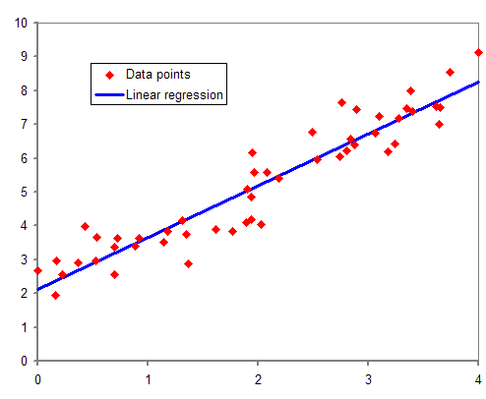

Slide 15
While training and building a regression model, it is these coefficients which are learned and fitted to training data. The aim of the training is to find the best fit line such that cost function is minimized. The cost function helps in measuring the error. During the training process, we try to minimize the error between actual and predicted values and thus minimizing the cost function.
In the figure, the red points are the data points and the blue line is the predicted line for the training data. To get the predicted value, these data points are projected on to the line.

Slide 16
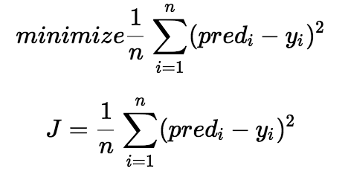
We choose the function above to minimize the error. We square the error difference and sum the error over all data points, the division between the total number of data points. Then, the produced value provides the averaged square error over all data points.
It is also known as MSE(Mean Squared Error), and we change the values of b₀ and b₁ so that the MSE value is settled at the minimum.

Slide 17
Cost function
A cost function, also known as a loss function or error function, is a mathematical function used to quantify the error or difference between the predicted values and the actual values in a machine learning model.
The primary goal of training a machine learning model is to minimize the cost function, thereby improving the model's accuracy.
The cost function helps to figure out the best possible values for a0 and a1, which provides the best fit line for the data points.

Slide 18

Cost function
Mean Squared Error (MSE) cost function is used, which is the average of squared error that occurred between the predicted values and actual values.
yi is the ith observed value.
ŷi is the corresponding predicted value.
n = the number of observations.

Slide 19
Gradient Descent
The next important terminology to understand linear regression is gradient descent. It is a method of updating b₀ and b₁ values to reduce the MSE. The idea behind this is to keep iterating the b₀ and b₁ values until we reduce the MSE to the minimum.
To update b₀ and b₁, we take gradients from the cost function. To find these gradients, we take partial derivatives with respect to b₀ and b₁. These partial derivatives are the gradients and are used to update the values of b₀ and b₁.

Slide 20
Advantages And Disadvantages
Advantages | Disadvantages
Linear regression performs exceptionally well for linearly separable data | The assumption of linearity between dependent and independent variables
Easier to implement, interpret and efficient to train | It is often quite prone to noise and overfitting
It handles overfitting pretty well using dimensionally reduction techniques, regularization, and cross-validation | Linear regression is quite sensitive to outliers
One more advantage is the extrapolation beyond a specific data set | It is prone to multicollinearity

Slide 21
Applications of Simple Linear Regression
Marks scored by students based on number of hours studied (ideally)- Here marks scored in exams are independent and the number of hours studied is independent.
Predicting crop yields based on the amount of rainfall- Yield is a dependent variable while the measure of precipitation is an independent variable.
Predicting the Salary of a person based on years of experience- Therefore, Experience becomes the independent while Salary turns into the dependent variable.

Slide 22
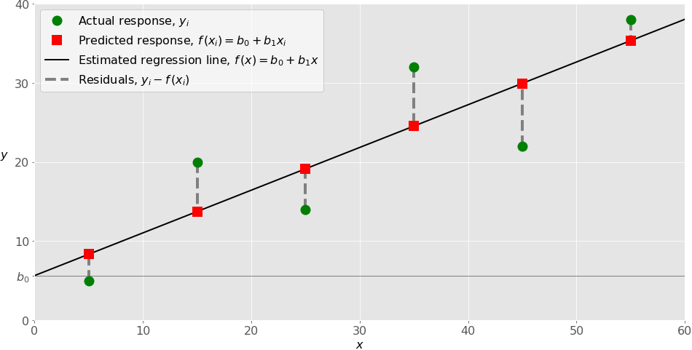

Slide 23
When implementing simple linear regression, you typically start with a given set of input-output (𝑥-𝑦) pairs. These pairs are your observations, shown as green circles in the figure. For example, the leftmost observation has the input 𝑥 = 5 and the actual output, or response, 𝑦 = 5. The next one has 𝑥 = 15 and 𝑦 = 20, and so on.
The estimated regression function, represented by the black line, has the equation 𝑓(𝑥) = 𝑏₀ + 𝑏₁𝑥. Your goal is to calculate the optimal values of the predicted weights 𝑏₀ and 𝑏₁ that minimize MSE and determine the estimated regression function.
The value of 𝑏₀, also called the intercept, shows the point where the estimated regression line crosses the 𝑦 axis. It’s the value of the estimated response 𝑓(𝑥) for 𝑥 = 0. The value of 𝑏₁ determines the slope of the estimated regression line.

Slide 24
The predicted responses, shown as red squares, are the points on the regression line that correspond to the input values. For example, for the input 𝑥 = 5, the predicted response is 𝑓(5) = 8.33, which the leftmost red square represents.
The vertical dashed grey lines represent the residuals, which can be calculated as 𝑦ᵢ - 𝑓(𝐱ᵢ) = 𝑦ᵢ - 𝑏₀ - 𝑏₁𝑥ᵢ for 𝑖 = 1, …, 𝑛. They’re the distances between the green circles and red squares. When you implement linear regression, you’re actually trying to minimize these distances and make the red squares as close to the predefined green circles as possible.

Slide 25
https://medium.com/machine-learning-with-python/multiple-linear-regression-implementation-in-python-2de9b303fc0c
https://medium.com/the-code-monster/split-a-dataset-into-train-and-test-datasets-using-sk-learn-acc7fd1802e0

Slide 26
Example-1
Predicting sales based on the money spent on TV, Radio, and Newspaper for marketing. In this case, there are three independent variables, i.e., money spent on TV, Radio, and Newspaper for marketing, and one dependent variable, i.e., sales, that is the value to be predicted.
Problem statement: Build a Multiple Linear Regression Model to predict sales based on the money spent on TV, Radio, and Newspaper for advertising.

Slide 27
Importing the Libraries
#Importing the libraries
import pandas as pd
import numpy as np
import matplotlib.pyplot as plt
import seaborn as sns

Slide 28
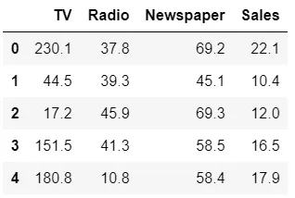
Reading the Dataset
#Reading the dataset
dataset = pd.read_csv("advertising.csv")
dataset.head()
Equation: Sales = β0 + (β1 * TV) + (β2 * Radio) + (β3 * Newspaper) + e

Slide 29
Setting the values for independent (X) variable and dependent (Y) variable
#Setting the value for X and Y
x = dataset[['TV', 'Radio', 'Newspaper']]
y = dataset['Sales']

Slide 30
Splitting the dataset into train and test set
from sklearn.model_selection import train_test_split
x_train, x_test, y_train, y_test = train_test_split(x, y, test_size = 0.3, random_state = 100)
from sklearn.model_selection import train_test_split: It is used for splitting data arrays into two subsets: for training data and testing data.
test_size: This parameter specifies the size of the testing dataset. The default state suits the training size. It will be set to 0.25 if the training size is set to default.

Slide 31
Implementing the linear model
#Fitting the Multiple Linear Regression model
mlr = LinearRegression()
mlr.fit(x_train, y_train)
To build a linear regression model, we need to create an instance of LinearRegression() class and use x_train, y_train to train the model using the fit() method of that class. Now, the variable mlr is an instance of the LinearRegression() class.

Slide 32
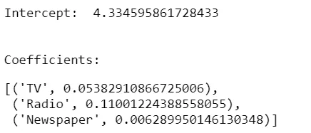
Model Equation
#Intercept and Coefficient
print("Intercept: ", mlr.intercept_)
print("Coefficients:")
list(zip(x, mlr.coef_))

Slide 33
Regression Equation
Sales = 4.3345+ (0.0538 * TV) + (1.1100* Radio) + (0.0062 *Newspaper) + e

Slide 34
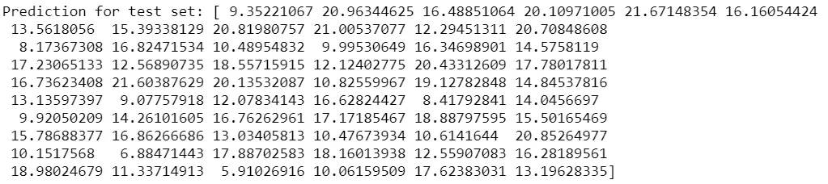
Prediction on the test set
#Prediction of test set
y_pred_mlr= mlr.predict(x_test)
#Predicted values
print("Prediction for test set: {}".format(y_pred_mlr))

Slide 35
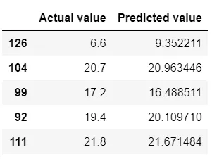
Actual values and the predicted values
#Actual value and the predicted value
mlr_diff = pd.DataFrame({'Actual value': y_test, 'Predicted value': y_pred_mlr})
slr_diff.head()

Slide 36
Evaluating the Model
#Model Evaluation
from sklearn import metrics
meanAbErr = metrics.mean_absolute_error(y_test, y_pred_mlr)
meanSqErr = metrics.mean_squared_error(y_test, y_pred_mlr)
rootMeanSqErr = np.sqrt(metrics.mean_squared_error(y_test, y_pred_mlr))
print('R squared: {:.2f}'.format(mlr.score(x,y)*100))
print('Mean Absolute Error:', meanAbErr)
print('Mean Square Error:', meanSqErr)
print('Root Mean Square Error:', rootMeanSqErr)

Slide 37
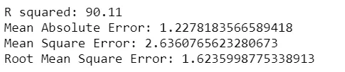
Evaluation Metrics

